Slide 1
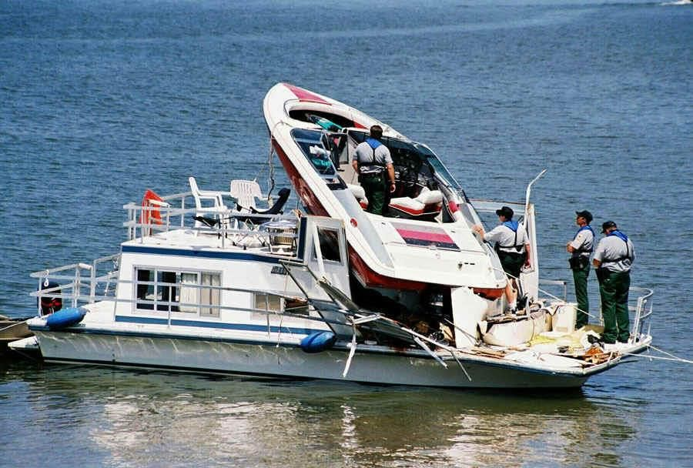
Recreational Boat Crash Analysis For the USA

Slide 2
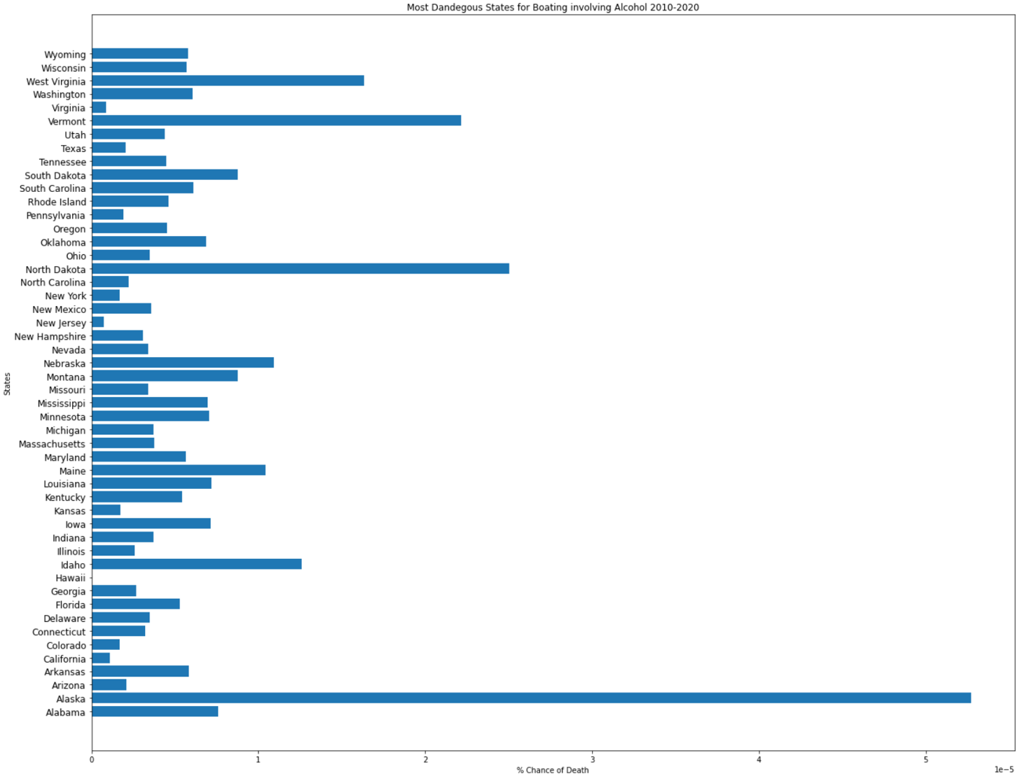
Most Fatalities Per State Involving Alcohol Per Average Population
This Plot shows the percentage chance of someone dying in each US state with alcohol as the main contributing factor. These figures were based on the total deaths with alcohol as the cause from 2010 through to 2020 and averaged per year, versus the average population for those years which was found in the US census 2010 and 2020.

Slide 3
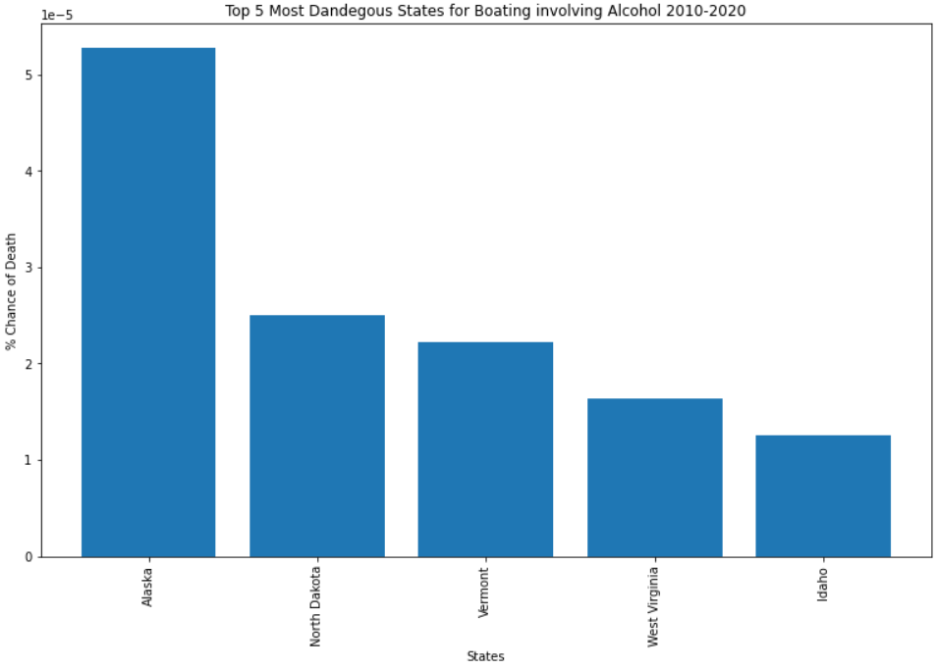
Most Fatalities Per State Involving Alcohol Per Average Population Top 5 States
The top 5 States for Fatalities with alcohol as the main cause, show that Alaska has over double the ‘Chance of Death’ as the 2nd highest state ‘North Dakota’.

Slide 4
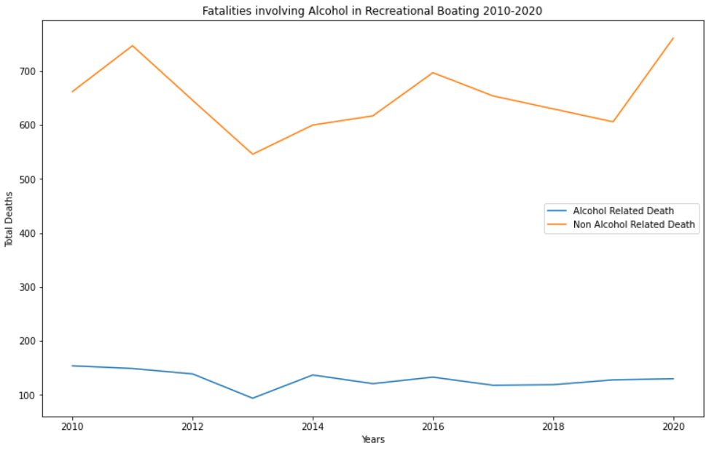
Fatalities Involving Alcohol versus Fatalities Not Involving Alcohol
This Plot show the comparison of Fatalities involving Alcohol as a main contributing factor compared to the total fatalities.
From this data we can see that although alcohol does contribute to the total deaths, it doesn’t make up a very high percentage as an overall factor of death in Boating.

Slide 5
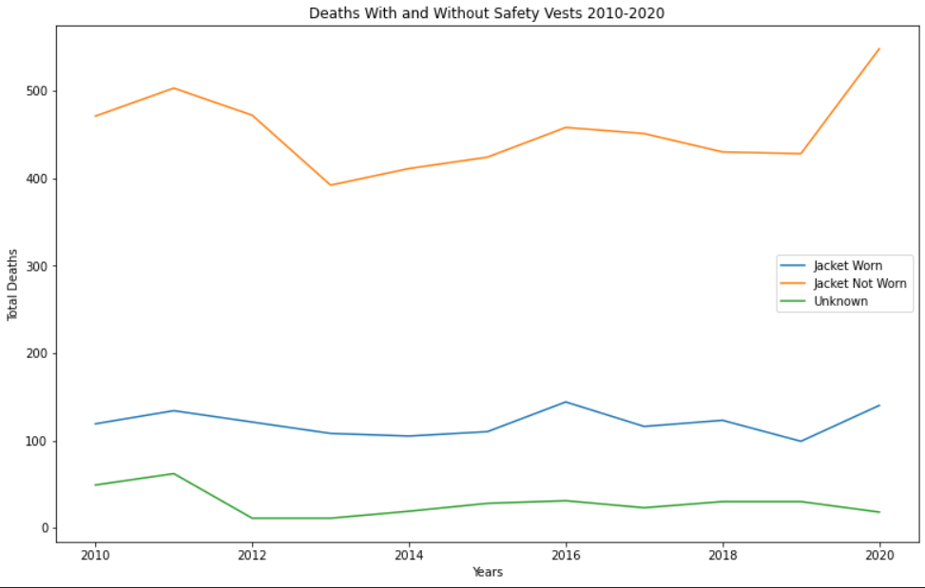
Fatalities Involving whether Safety Vests were worn between 2010-2020
The total deaths whilst wearing a safety vest has barely altered over the previous 10 years, and neither has the total deaths whilst wearing one. This graph clearly shows that there is a far higher chance of dying if you don’t wear a safety vest

Slide 6
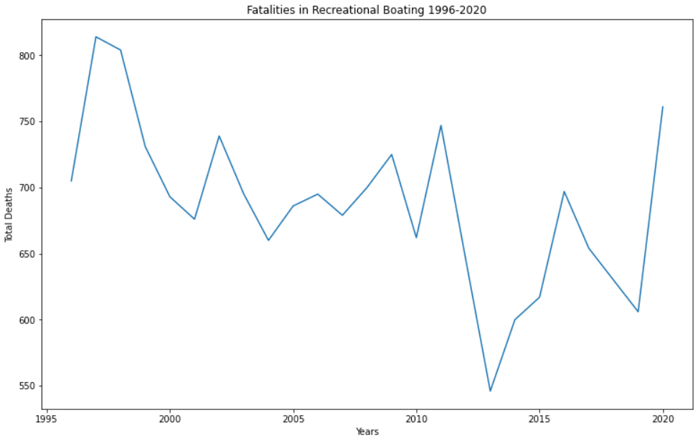
Fatalities in Recreational Boating 1996-2020
Fatalities in Recreational Boating since 1996 seemed to be heading in downward trend but over the more recent years appears to have a few spike years climbing back over 750 deaths in 2020.

Slide 7
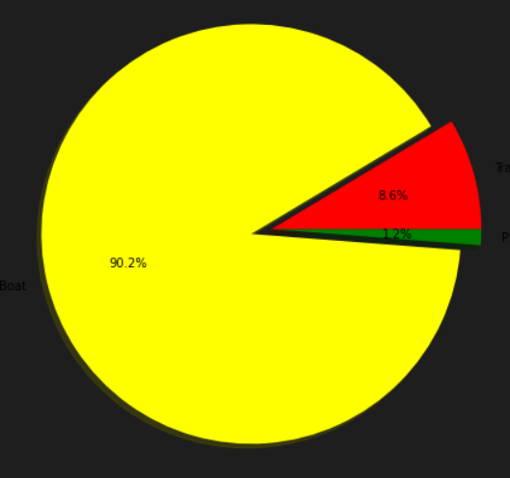
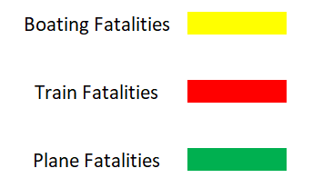
Comparing Total Boating, Train and Plane Fatalities between 2010-2020
This Pie graph shows the comparison between total deaths in Recreational Boating, Planes and Trains.
Slightly surprising Boats accounted for just over 90% of transport fatalities with these three modes of transport, with the other 2 making up less than 10%.
Cars were left out as the number of fatalities is so overwhelming in number for a head to head analysis.

Slide 8
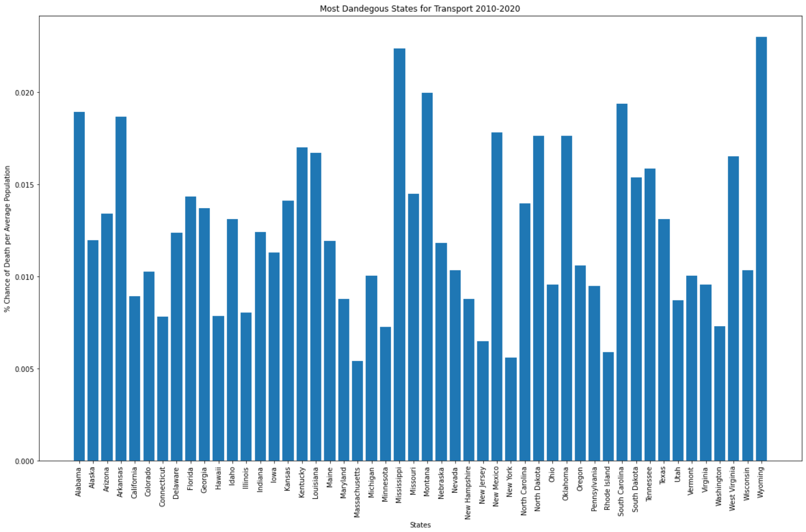
Most Dangerous States for Transport by Average Population 2010-2020
This Graph show the culmination of total fatalities for Trains, Cars, Planes, and Boats in all US states. Although Cars make up the vast majority of deaths, this graph takes into account the population average to give a better overall view of which states are Safest, and which are the most Dangerous.

Slide 9
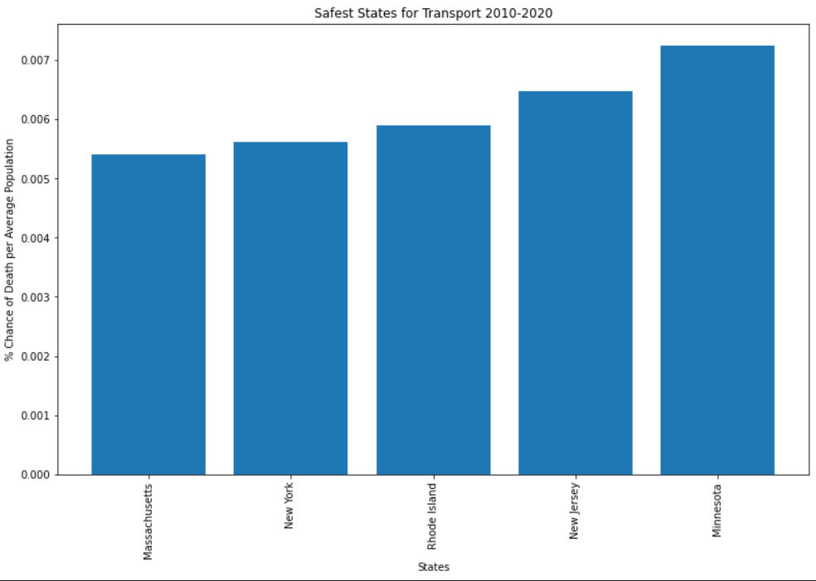
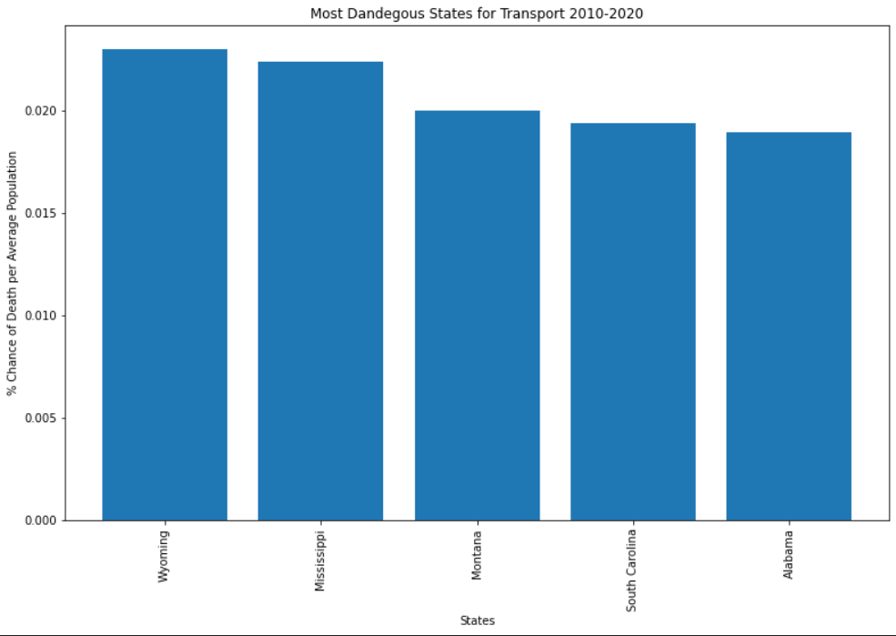
Top 5 Safest & Most Dangerous States for Transport by Average Population
In conclusion, the Safest states when it comes to Fatalities in Transport per capita is Massachusetts, followed by New York. Whereas the most dangerous states are Wyoming and Mississippi.

Slide 10
Summary
Alcohol shows to be only a minor factor in the cause for overall fatalities in boating.
Wearing a safety vest has far fewer deaths than compared to Not wearing a safety vest making a lack of safety vest a major factor in fatalities in boating.
There is only a slight trend downwards in the total fatalities in Boating over the past 25 years.
Recreational Boating has a far higher Fatality rate than either Planes or Trains, but pales in comparison to Cars.
With all 4 modes of transport explored the Safest states per capita were Massachusetts, followed by New York, and the most dangerous states Wyoming and Mississippi.
Post Mortem
Several difficulties arose, which included being unable to obtain good international data so we were restricted to the USA, as it has a solid array of data available.
Originally we wanted to focus on Plane Fatalities data but quickly realized there would not be enough for our whole group to explore, so we decided to include Car, Train and Boat Fatalities, for exploration.
Due to Car deaths being so overwhelming in numbers, it was hard to draw head to head comparisons with the other 3 modes of transport other than by miles travelled per death. Unfortunately this data was unavailable for Boats.
Ideally I would have liked to do a heat map of the US for all the Boat fatalities to see if more were located on the coast as opposed to rivers and lakes, but the Latitude and Longitude of these fatalities was unavailable.
Data Sources –
Recreational Boating Statistic, U.S. Department of Homeland Security U.S. Coast Guard Office of Auxiliary and Boating Safety
US Census 2010 & 2020 for Population data by State

Slide 11
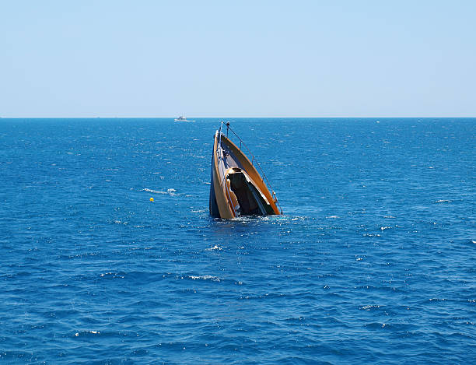
The End
Any Questions?

